Slide 1
DIGI
SOL
FARMS

Slide 2
Data Center
Solar Hybrid Data Center
100% Solar Data center
1-250Mw/hr Solar Farm with 70% Data Center power usage
1 Gw/hr Solar Farm with 10-30% Data Center power usage
DigiSol Farms around the country.
* Solar is just an example of renewable energy

Slide 3
HQ Server
Farm’s Main Server
Farm’s
Main Server
Farm’s Main Server

Slide 4
Dedicated Mainframe
Conventional power server
Motherboard A
Motherboard B
Targeted power server (deep ai, video rendering)
Motherboard C
Farm’s Main Server
Dedicated servers
Machines
Clients
Cluster
Cluster
Cluster

Slide 5
Cluster
Ssd
Gpu
Ram

Slide 6
Motherboard A Cluster
Motherboard A Cluster
Pool
Motherboard A Cluster

Slide 7
Solar Plant
Power Distribution Units (Tesla’s Megapacks are out! 3Mw Plug N Play)
Pool
Conventional Power Grid
Servers

Slide 8
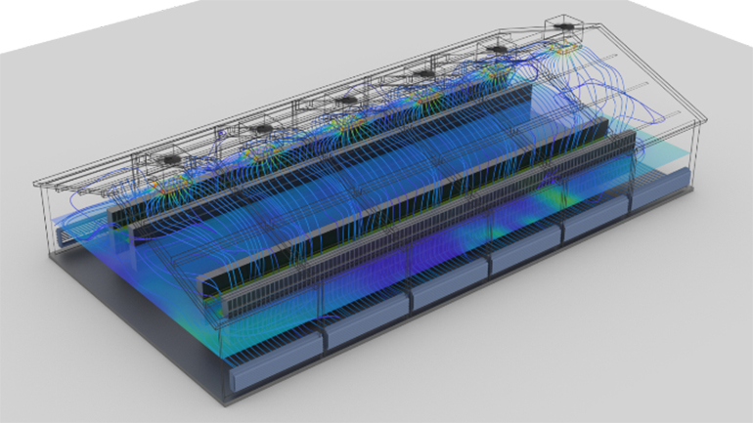

Slide 9
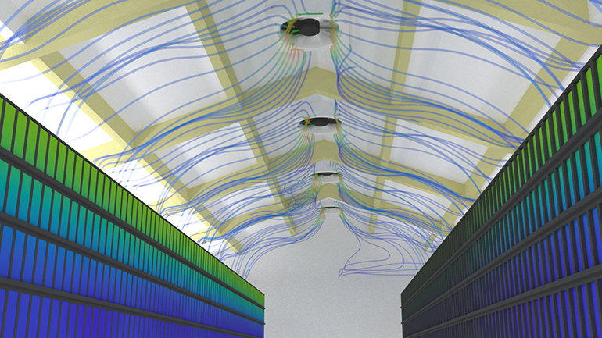

Slide 10
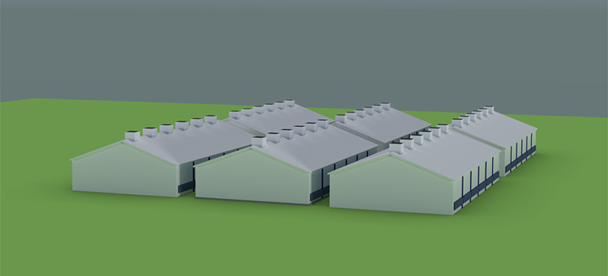

Slide 11
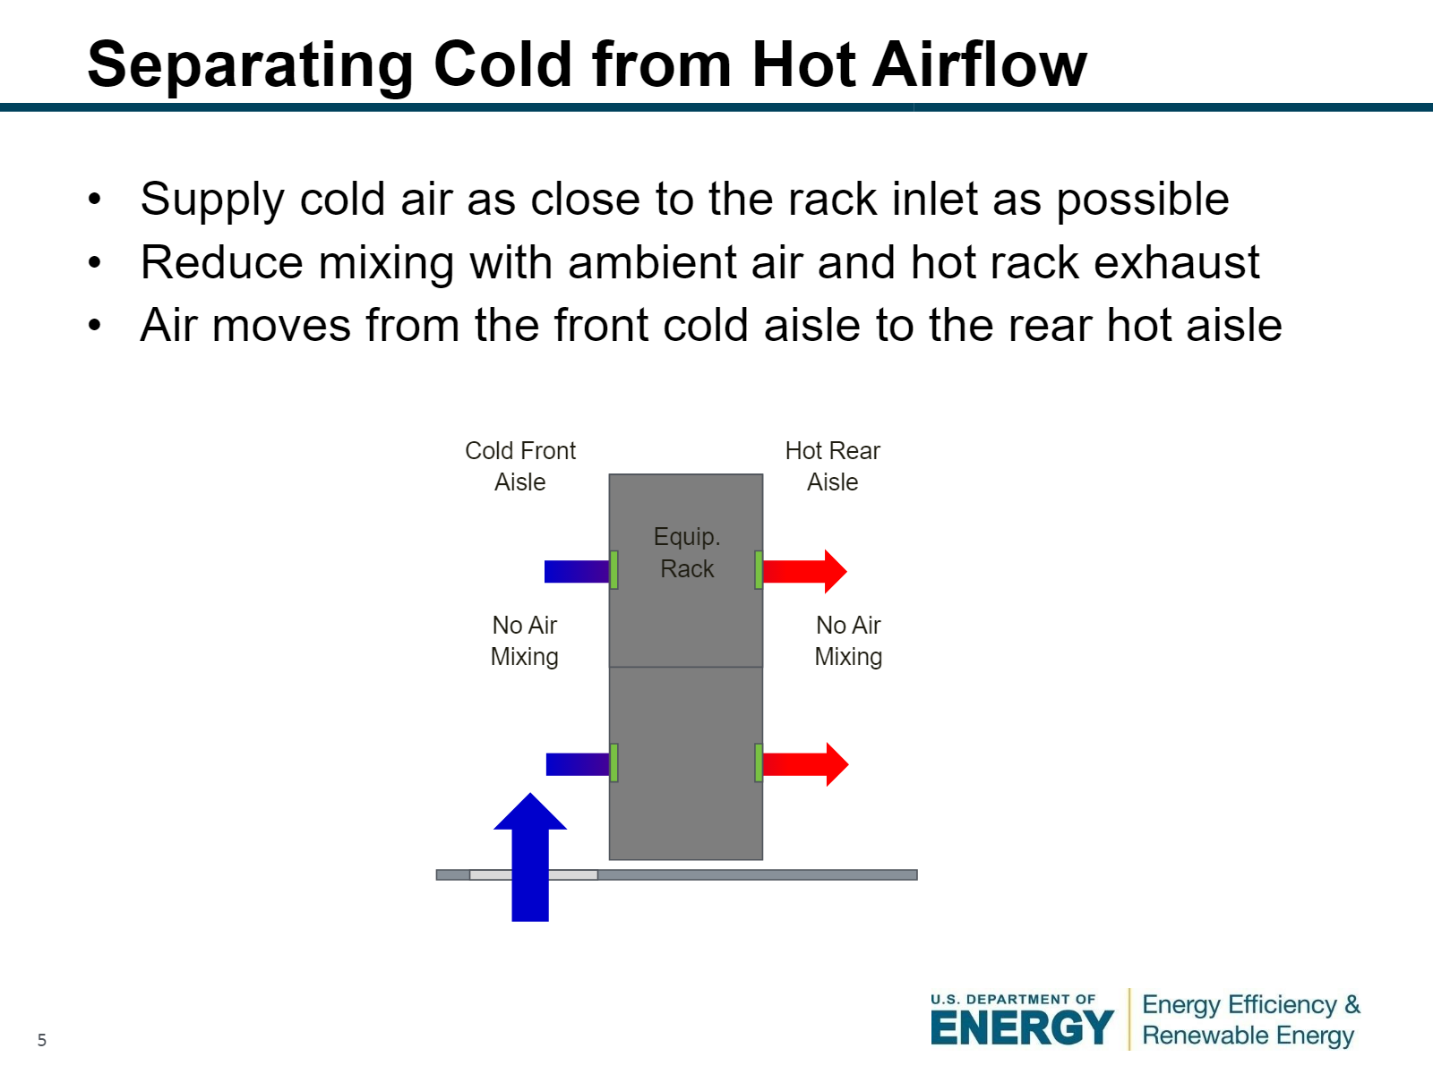

Slide 12
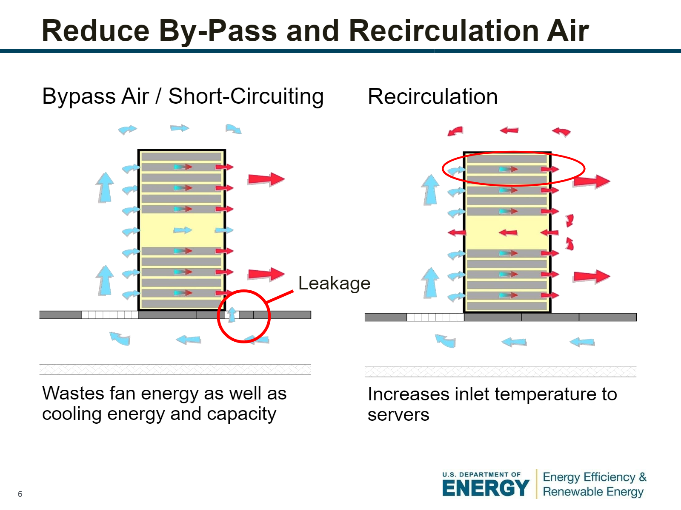

Slide 13
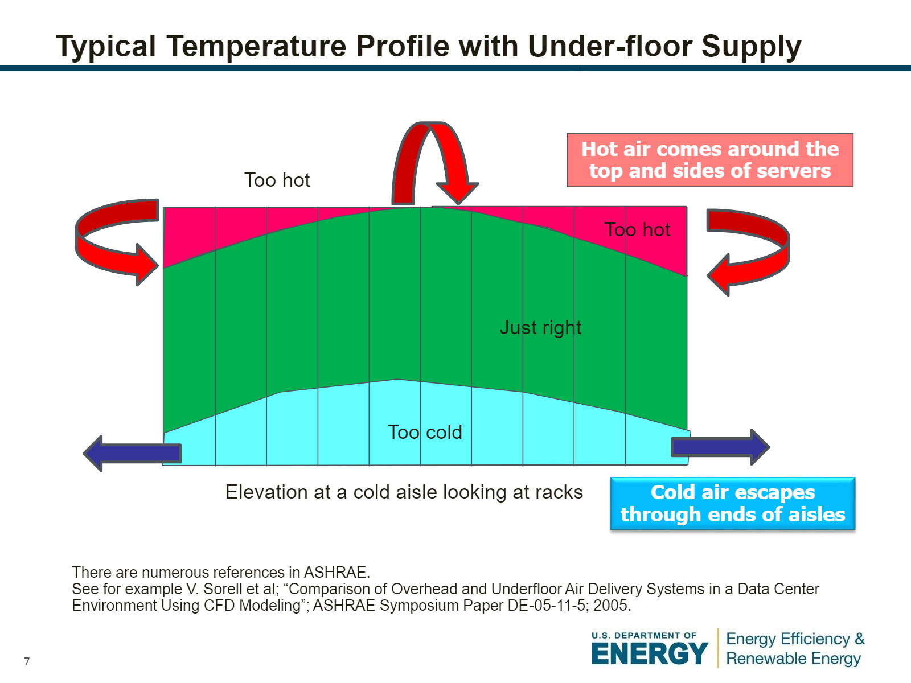

Slide 14
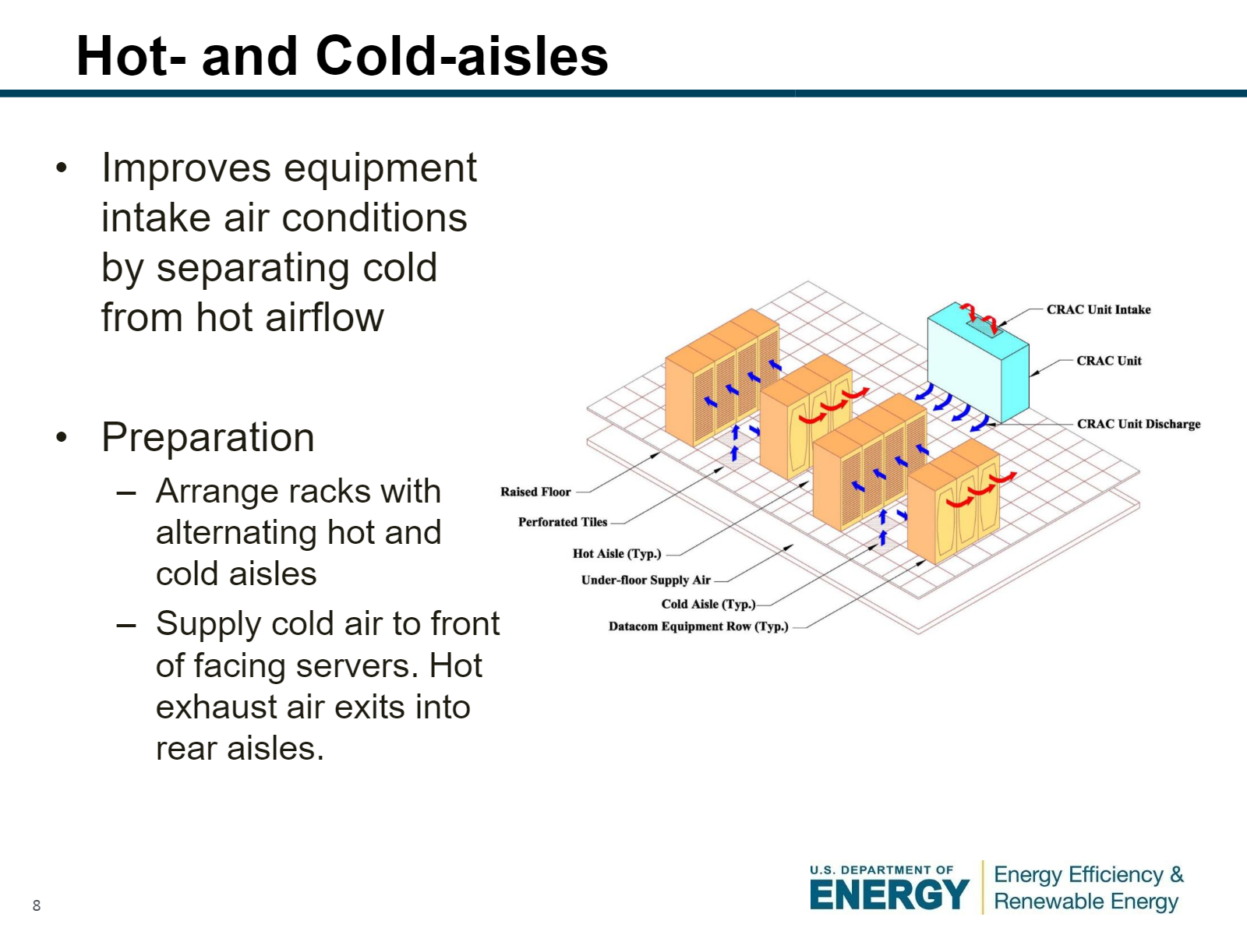

Slide 15
